Slide 1

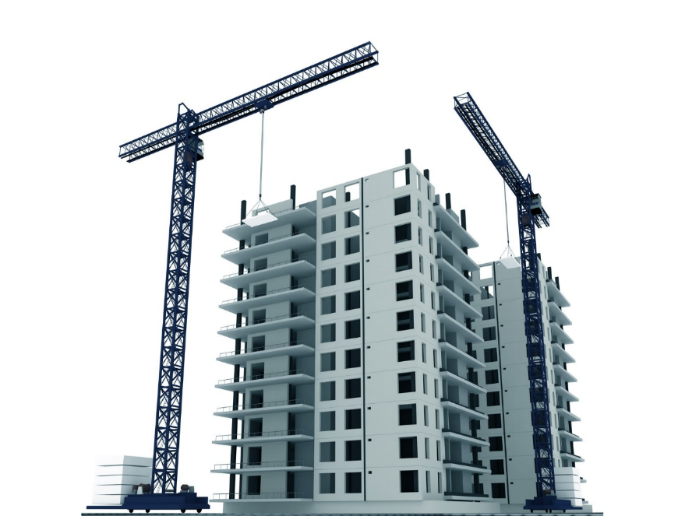
HI-TECH PROJECTS Pvt. Ltd.
PROJECT REVIEW MEETING
PROJECT NAME: TORRENT POWER , KATARGAM
PRESENTED BY: TPKS.QS
DATE: 15-02-2022

Slide 2
PROJECT DETAILS
Project: | PSC Building at Torrent Power " B " Station , Katargam , Surat
Client: | Torrent Power Ltd.
Architect: | Munjal Bhatt Architects.
Structural Consultant: | S3M Design Consultants LLP
Consultant: | Shah Consultancy TPI
Tender Cost: | 28.62 Cr.
Start Date (As per PO): | 17-08-2020
Finish Date (As per PO): | 16-02-2022
Actual Start Date: | 02-09-2020
Finish Date (As per Bar Chart): | 10-08-2022
Total Duration Vs Lapsed in days: | Say 696 Vs 176
Project plan Vs Achievement: | 12.12 Vs 10.26 Cr.
Billing Till Last Month: | 10.26 Cr
PROJECT REVIEW MEETING JAN’22

Slide 3

REVIEW OF LAST MOM
MOM - PROJECT REVIEW MEETING
DEPARTMENT |  |  | Date |  | 28/12/2021
PARTICIPANTS |  | Execution Incharge (Mr. Jayesh kumar Mistry)
Sr. | Agenda Points | Key Measurable / Action to be Taken | Responsible Person | Responsible Person | Target Date | Progress Status | Action Taken
1 | Planning | Review the schedule for the project to finish within the stipulated time period. | PM |  |  | In Progress
2 | Execution | Give floor wise target completion dates to the sub-contractors with manpower requirement and quantity of work. | PM |  |  | In Progress
3 | PRM Presentation | Add a slide about reason of variance for feasibility vs. achievement. | PM |  |  | Completed
4 | Sparing in ERP | Spare the extra material/asset from ERP little in advance to enable more effective material/asset management. | PM |  |  | Completed
5 | Store | At the end of the month, run closing stock report in ERP and check with physical stock on site with the help of store in-charge for more accurate data. Make it a practice. | PM |  |  | Every month Check in ERP Routine Basis
6
7
8
PROJECT REVIEW MEETING JAN’22

Slide 4
PLAN V/S ACTUAL
Project Value | For the month of January’22 |  |  |  | Cumulative for the Project up January’22
 | Sales as per Bar chart | Sales as per Feasibility | Sales (Client Bill) | % Achievement | Cumulative Sales as per Bar chart | Cumulative (Client Bill + WIP) Sales | % Achievement wrt Bar chart
A | B | C | D | E = D/C | F | G | H = G/F
2861.65 | 111.37 | 119.35 | 32.31 | 27.07% | 1212.64 | 1026.27 | 84.63%
=> Amendment Amount up to Jan-22 – 17.79 Lacs
PROJECT REVIEW MEETING JAN’22

Slide 5
REASON OF VARIANCE FOR FEASIBILITY VS. ACHIEVEMENT.
Not available of 1st Floor Slab (+6.900 Lvl.) drg. due to change in Structure Design.
PROJECT REVIEW MEETING JAN’22

Slide 6
NEXT QUARTER PLAN
HI TECH PROJECTS PVT. LTD.
PROJECT: - | PSC Building at Torrent Power " B " Station Katargam , Surat Jan-22 |  |  |  |  |  |  | Date: 15-02-22
MONTH:-
Project Value (in lacs) | Cumulative Bill Achieved up to previous month | % Completed | Feb-22 | Mar-22 | Apr-22 | Quarter's Target | Balance Amount | Remarks
 |  |  | Amount | Amount | Amount | Amount
A | B | C = B/A | D | E | F | G = D+E+F | H = A - (B+G)
2861.65 | 1026.27 | 35.86% | 96.15 | 116.18 | 132.05 | 344.38 | 1491.00
PROJECT REVIEW MEETING JAN’22

Slide 7
MANPOWER STATUS
PROJECT NAME: PSC Building at Torrent Power " B " Station , Katargam , Surat
Row Labels | Manpower Requirement for Feb’22 |  |  | Total Available in Feb’21 | Shortfall
 | Skilled | Unskilled | Total
A | B | C | D=B+C | E | F=D-E
REINFORCEMENT | 10 | 10 | 20 | 15 | 05
SHUTTERING | 15 | 15 | 30 | 28 | 02
UNSKILLED | 02 | 23 | 25 | 20 | 05
MASONRY & PLASTERING | 10 | 18 | 28 | 09 | 19
WATER PROOFING | 06 | 00 | 06 | 04 | 02
SAFETY | 01 | 01 | 02 | 00 | 00
TOTAL | 44 | 67 | 111 | 71 | 40
PROJECT REVIEW MEETING JAN’22

Slide 8
LAST 3 MONTH VALUATION
STOCK VALUATION
Category Name | Dec-21 | Jan-22 | Feb-22
Consumable Asset | 1.18 | 15.97 | 7.72
Material | 25.62 | 17.90 | 42.24
Oil & Fuel | 0.01 | 0.01 | 0.01
Sparepart | 0.68 | 0.68 | 0.62
Total | 27.49 | 34.56 | 50.59
PROJECT REVIEW MEETING JAN’22

Slide 9
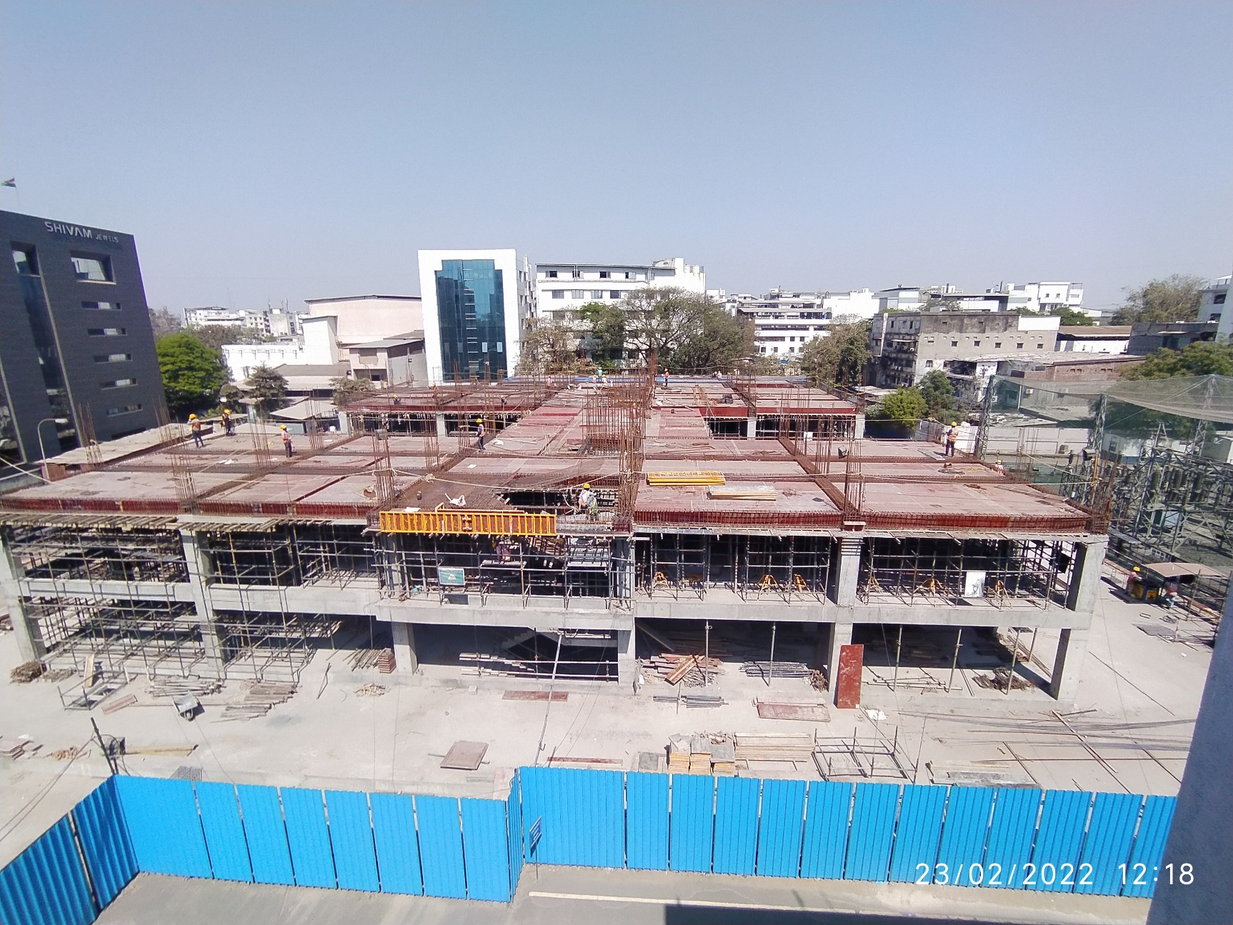
PROJECT CURRENT STATUS PHOTO’S
PROJECT REVIEW MEETING JAN’22

Slide 10
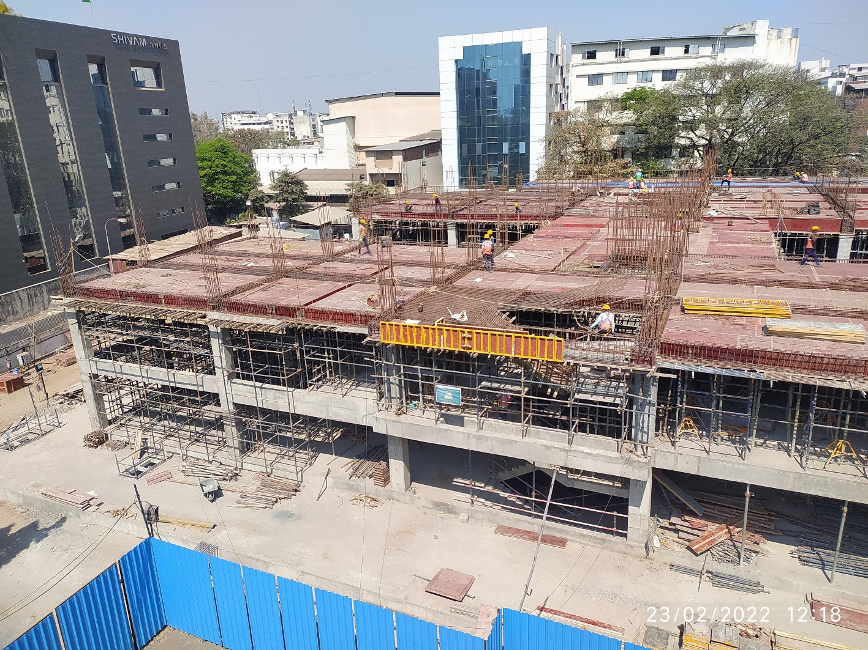
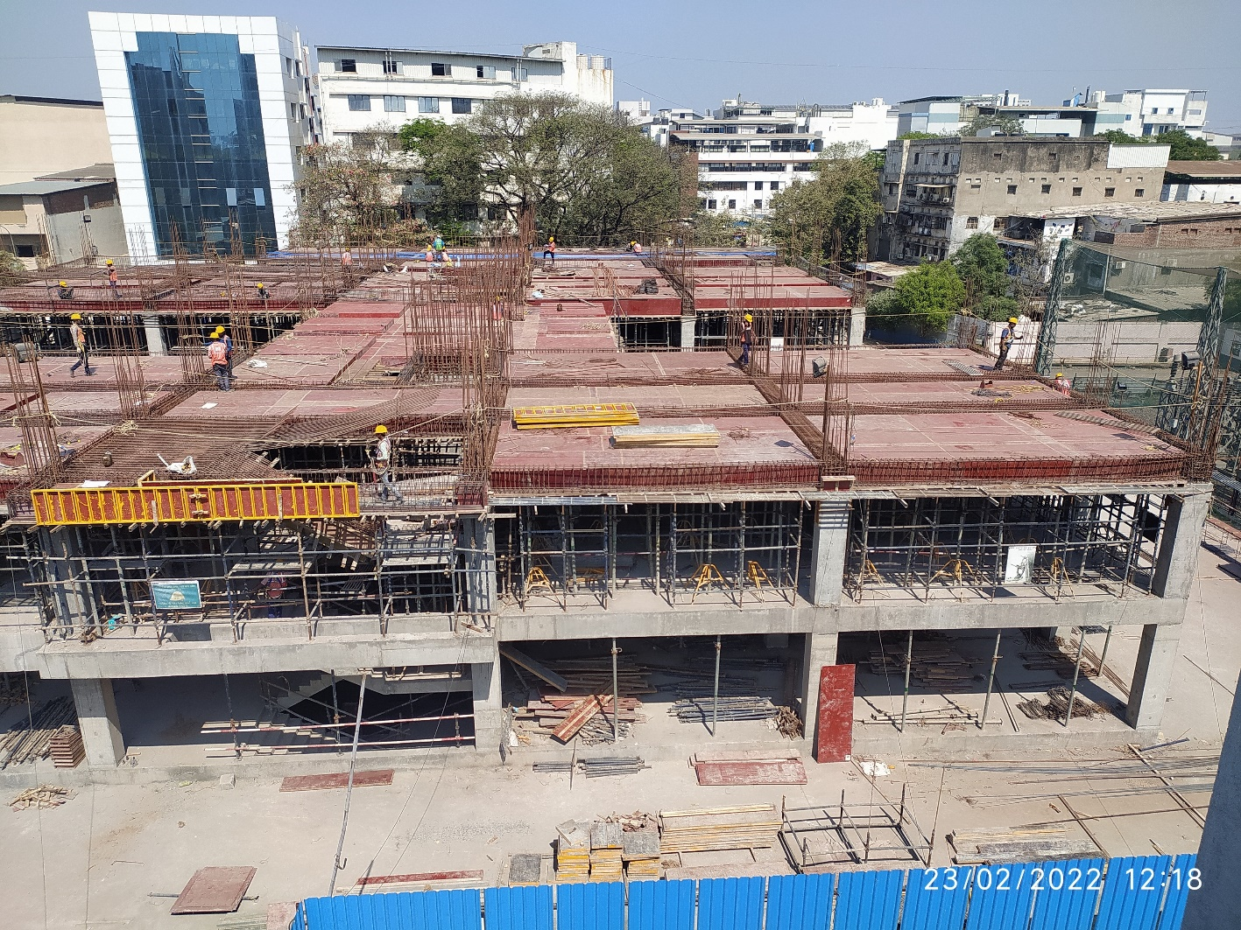
PROJECT CURRENT STATUS PHOTO’S
PROJECT REVIEW MEETING JAN’22

Slide 11
SUPPORT FROM HEAD OFFICE
PROJECT REVIEW MEETING JAN’22

